Slide 1

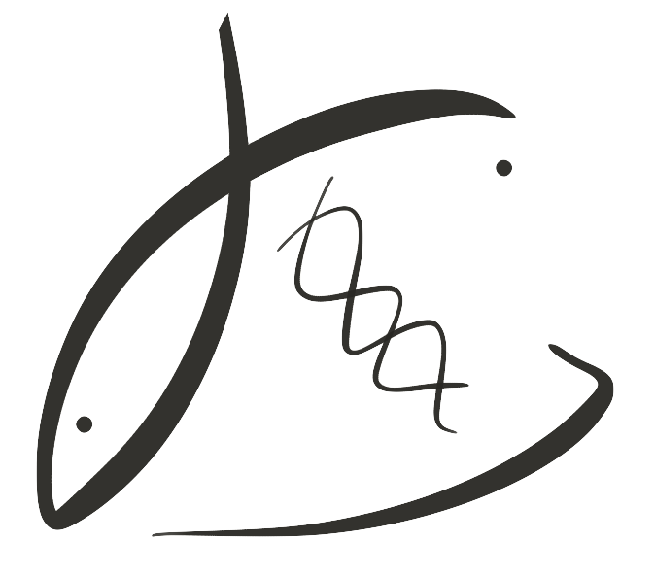



Carryover effects of winter warming in the Olympia oyster
Laura H Spencer, Erin Horkan, Ryan Crim, Steven Roberts
Roberts Lab
School of Aquatic and Fishery Sciences
University of Washington
NSA-PCS & PCSGA Joint Virtual Meeting, October 2020
https://laurahspencer.github.io/LabNotebook/
Notes:
Introduce co authors

Slide 2
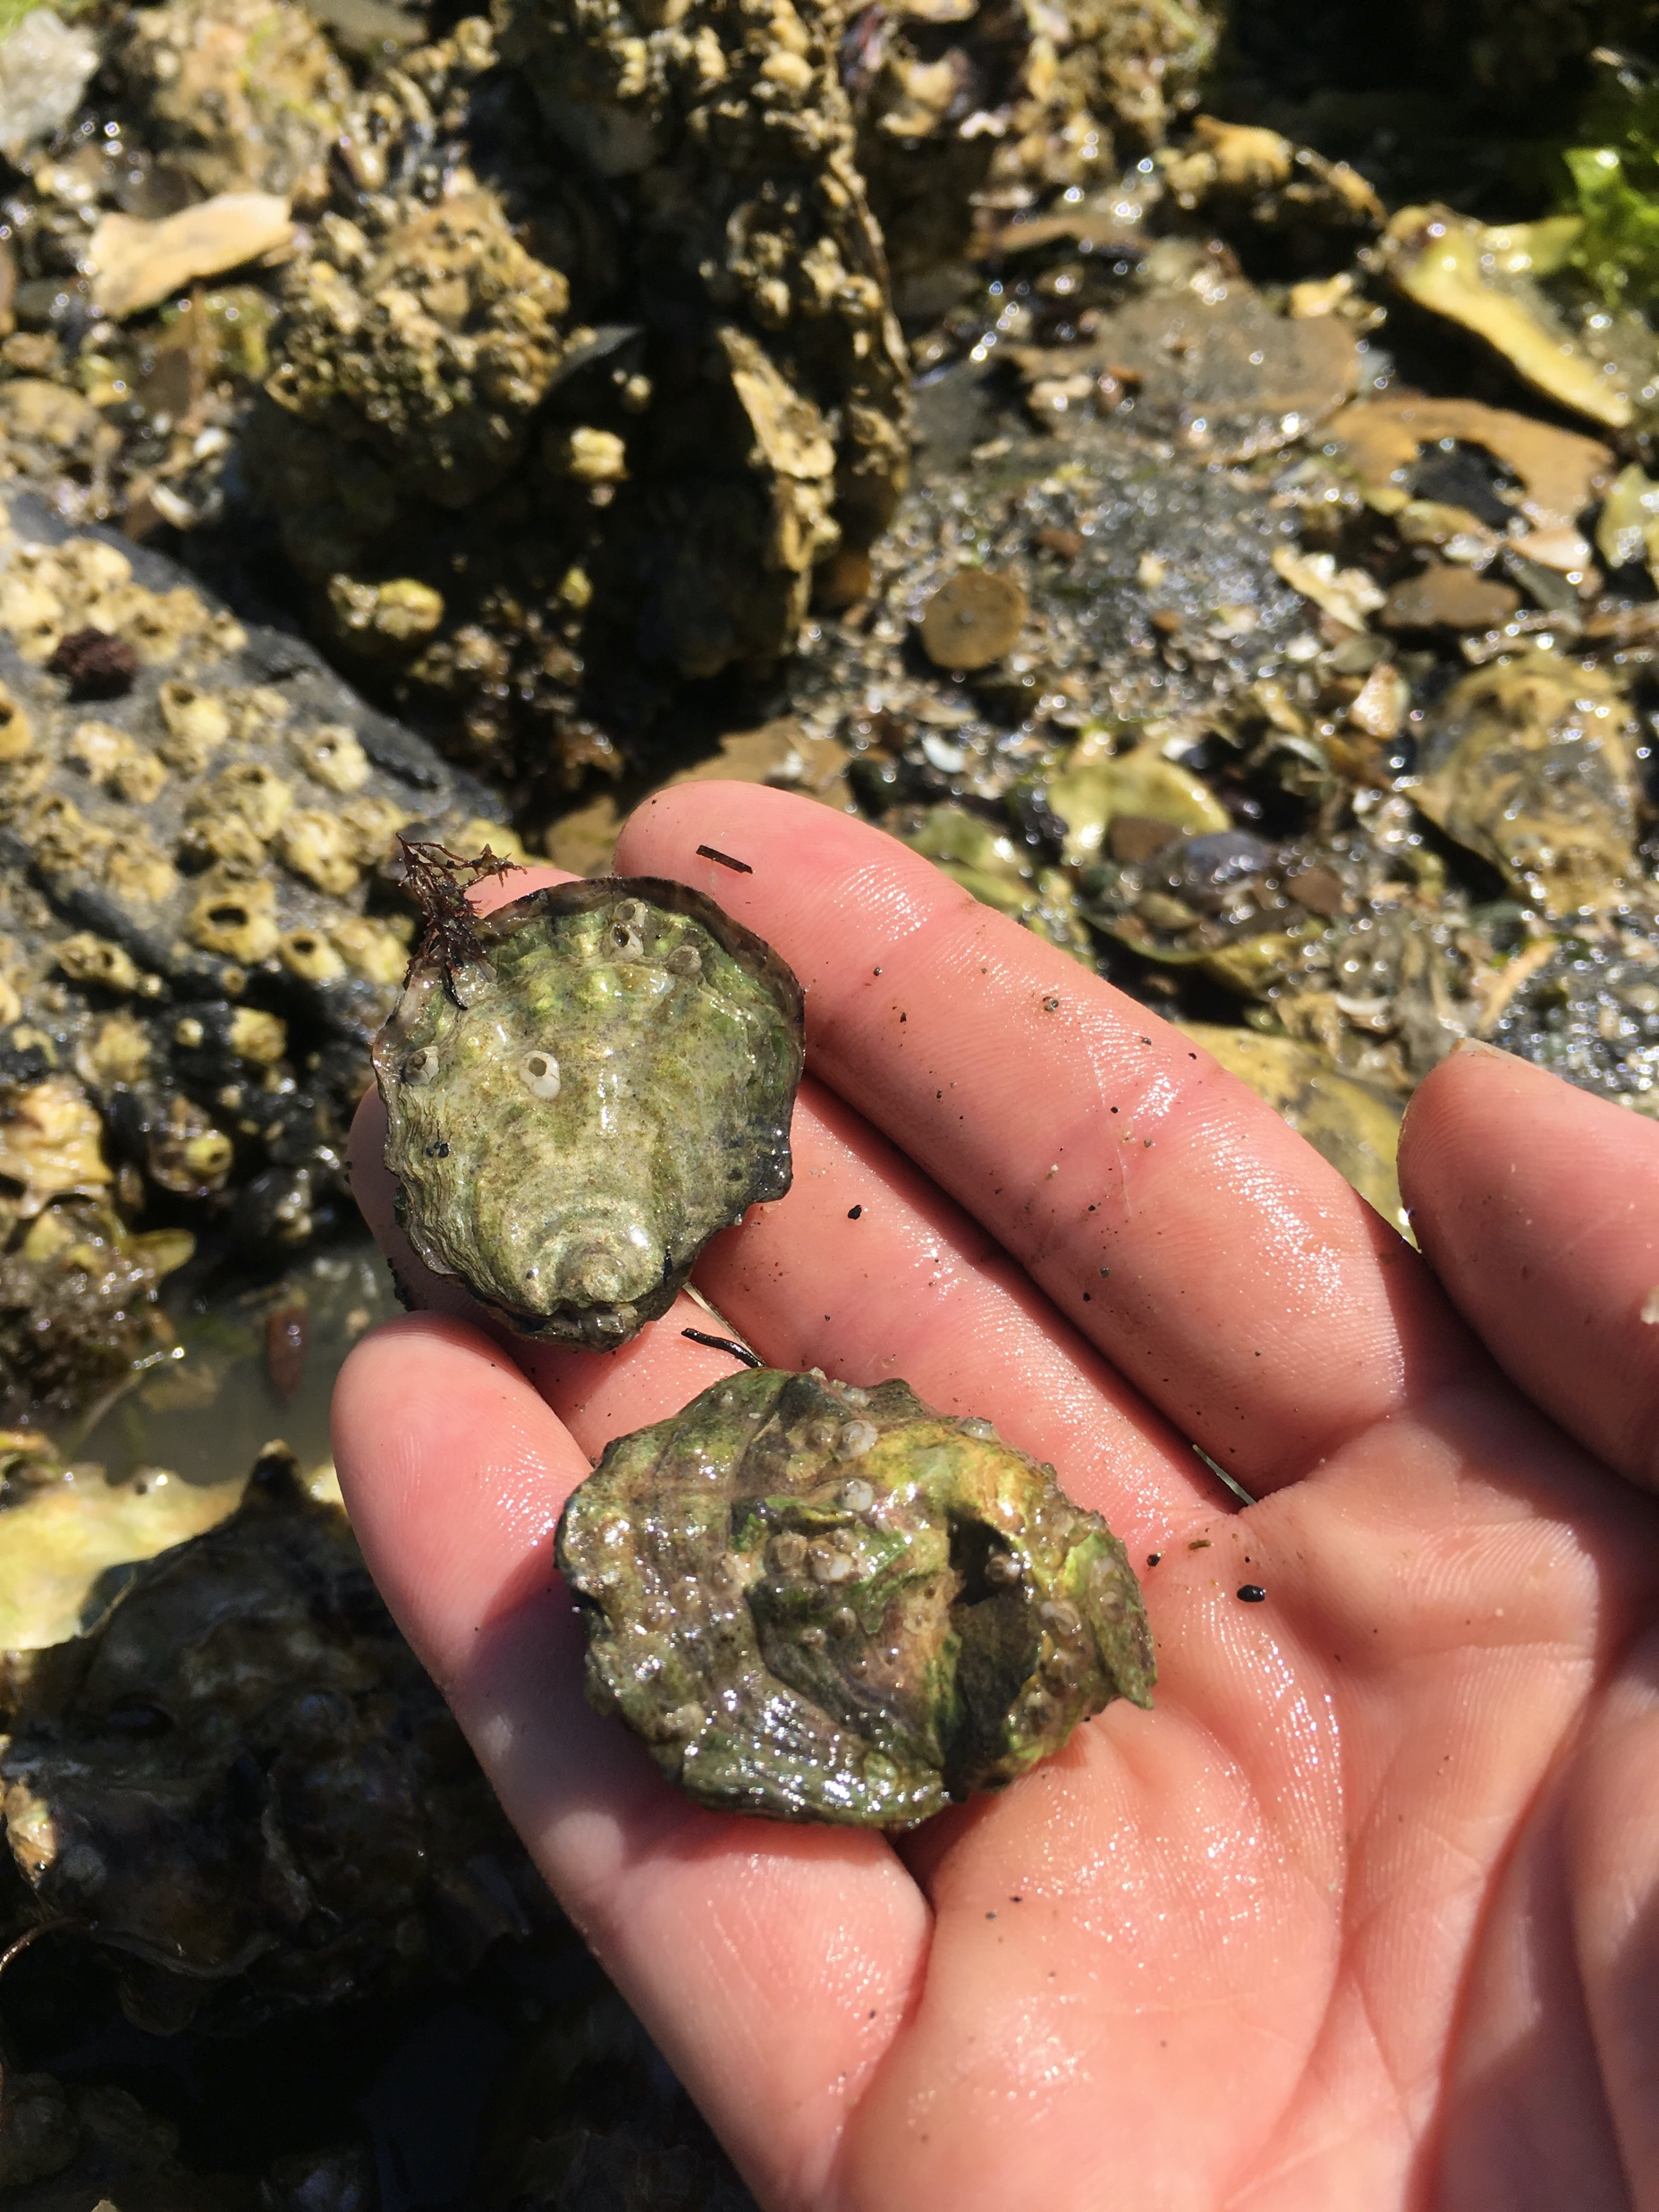
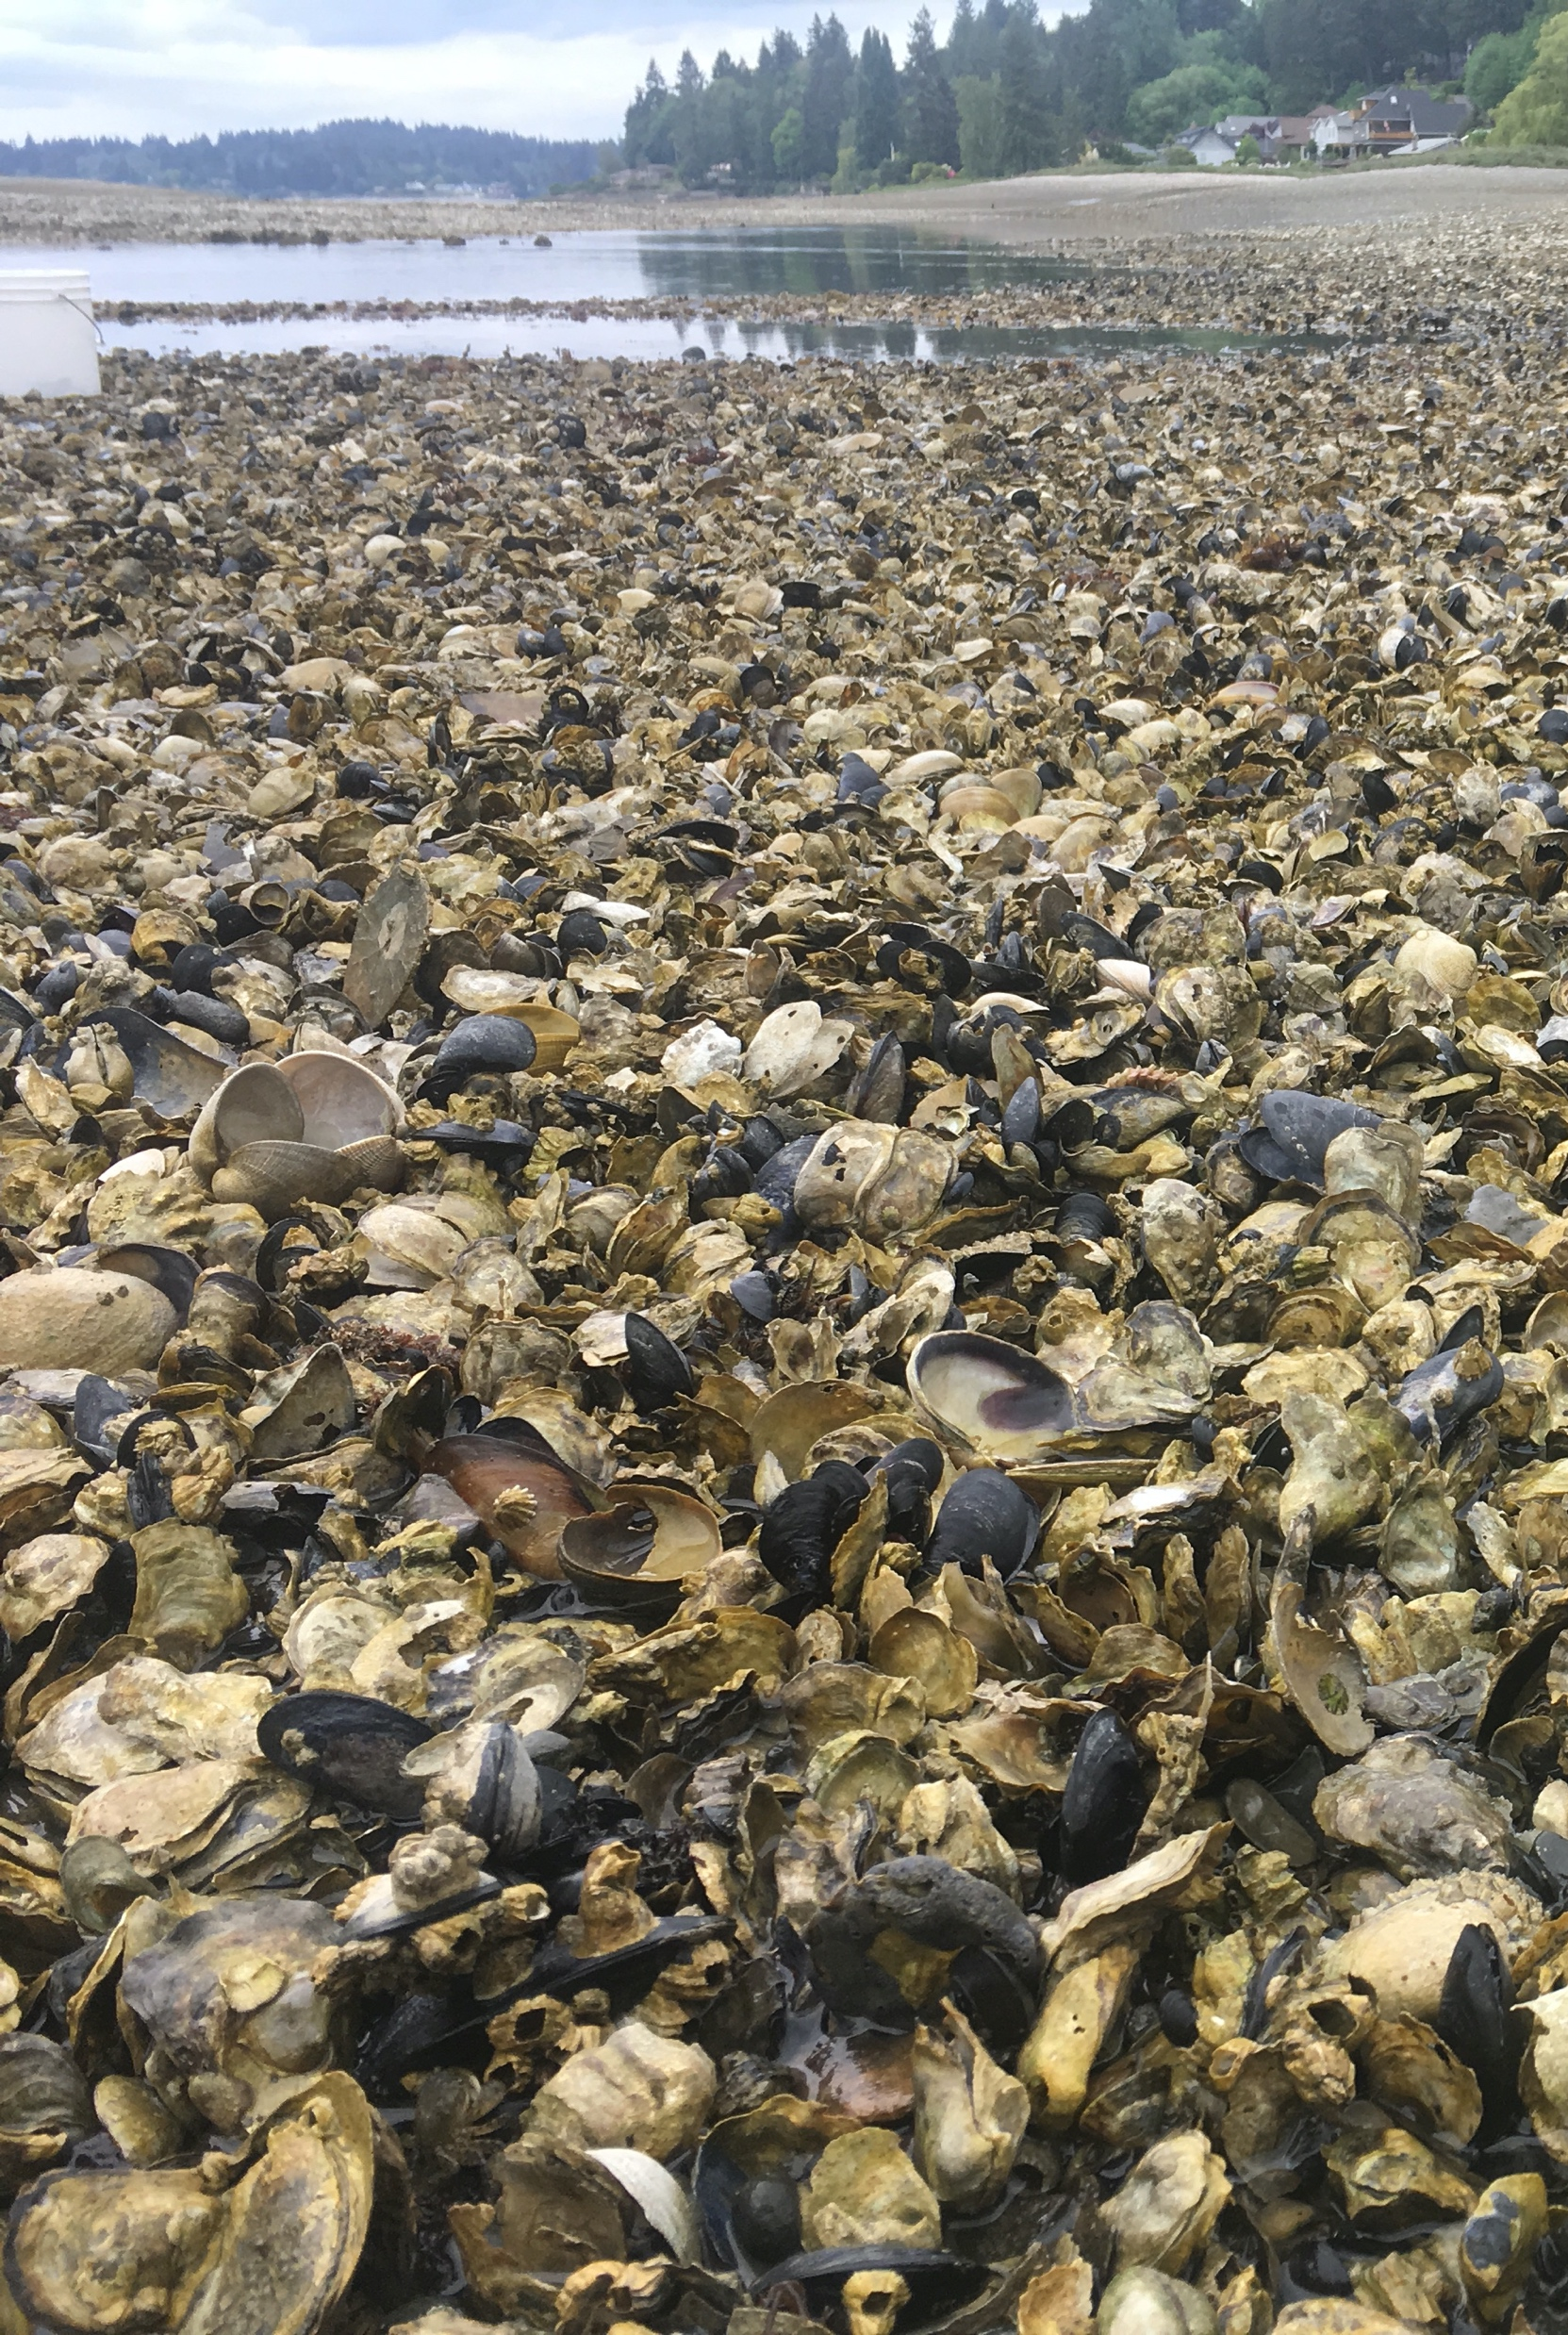
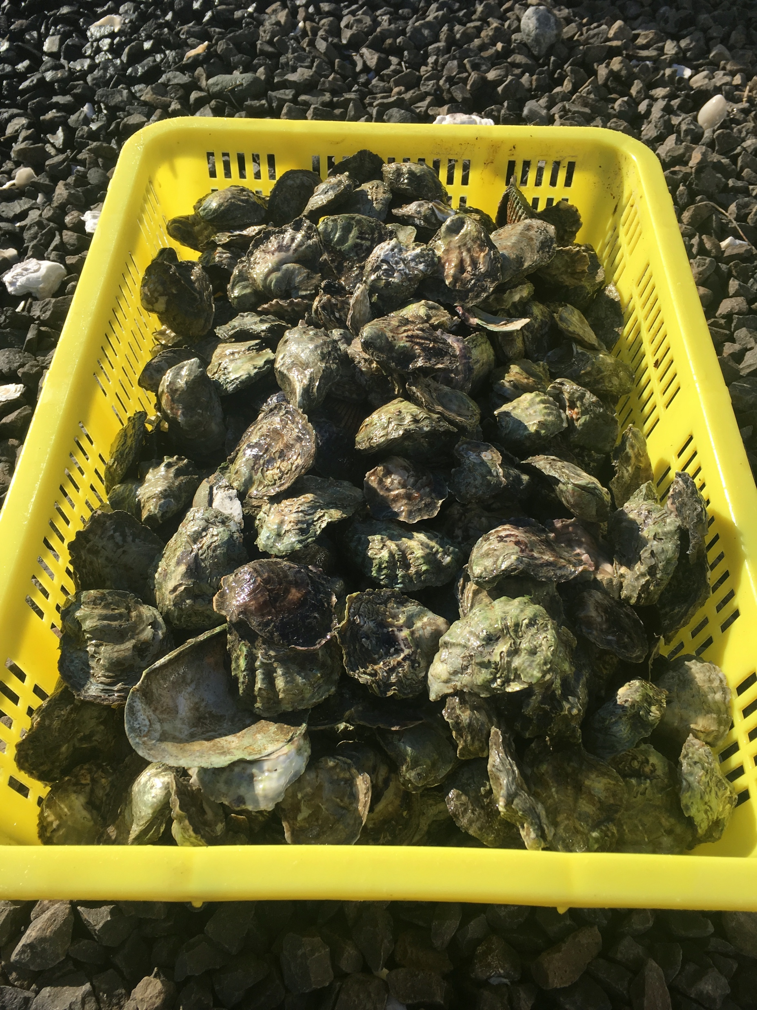
The Olympia oyster, Ostrea lurida
Impacts of ocean warming?
Notes:
Native to Pacific Coast N. America
Being restored along the coast
Like other calcifiers, it’s threatened by changing ocean conditions
One big question- how will ocean warming impact Olympia oyster, particularly in the temperate PNW

Slide 3
Impacts of warming on Olympia oysters will likely vary by season in PNW
Some dominant activities by season
Spring
Gametogenesis, spawning, fertilization, recruitment, growth
⇧ fertilization, gametogenesis, larval development, & feeding rates
(Parker, Ross & O’Connor 2009,
Rico-Villa, Pouvreau & Robert 2009; Gray & Langdon 2018; Lawlor & Arellano 2020)
⇩ larval duration / dispersal
(O’Connor et al. 2007)
Summer & Fall
Spawning, gametogenesis, recovery, growth
⇧ heat stress, infection/disease, mortality
⇧ or ⇩ growth rates
(Li, Abbott, Li & Benkendorff 2007; Green et al. 2019; Lawlor & Arellano 2020)
Winter
Metabolic depression, dormancy (?)
Early spawning in spring,
⇧ sperm development
(Spencer et al. 2020)
Offspring?
Effect of warming
Notes:
How warming will effect the Olympia oyster, however, isn’t a simple question
Temperature controls so many physiological processes in ectothermic animals
Effects of wamring will depend on the time of year, and what’s happening to the animal’s physiology.
To demonstrate this, I’m going to briefly walk through some dominant physiological activities by season, and how warming might impact these processes.
Most research has looked at heat stress / acute warming – very little on moderate warming and temperatures representative of winter conditions.
Could warmer winters impact larvae spawned in the spring? This question arose a few years ago in the PSRF restoration hatchery, when poor larval production occurred in the spring following the marine heat wave – that heat wave (winter 2015) resulted in anomalously warm winter
Li, Y., Qin, J. G., Abbott, C. A., Li, X., & Benkendorff, K. (2007). Synergistic impacts of heat shock and spawning on the physiology and immune health of Crassostrea gigas: an explanation for summer mortality in Pacific oysters. American Journal of Physiology. Regulatory, Integrative and Comparative Physiology, 293(6), R2353–R2362.
“Summer Mortality” in Pacific oysters common

Slide 4
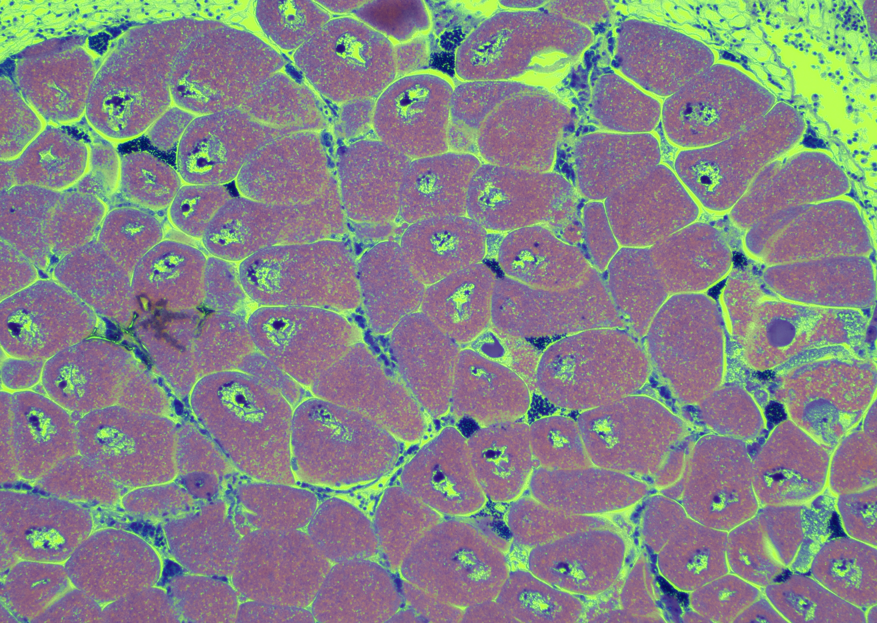
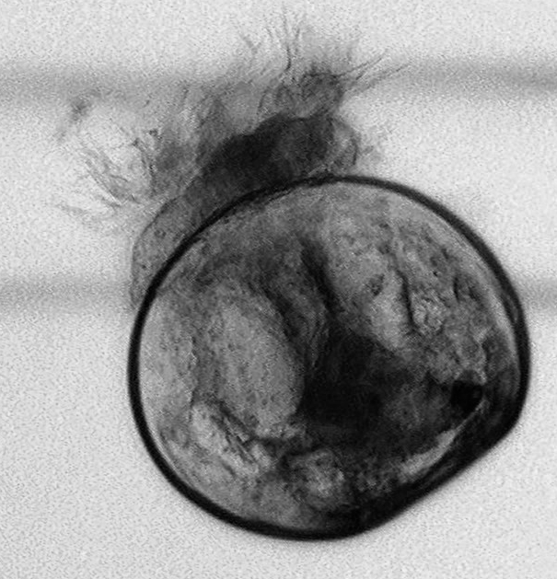
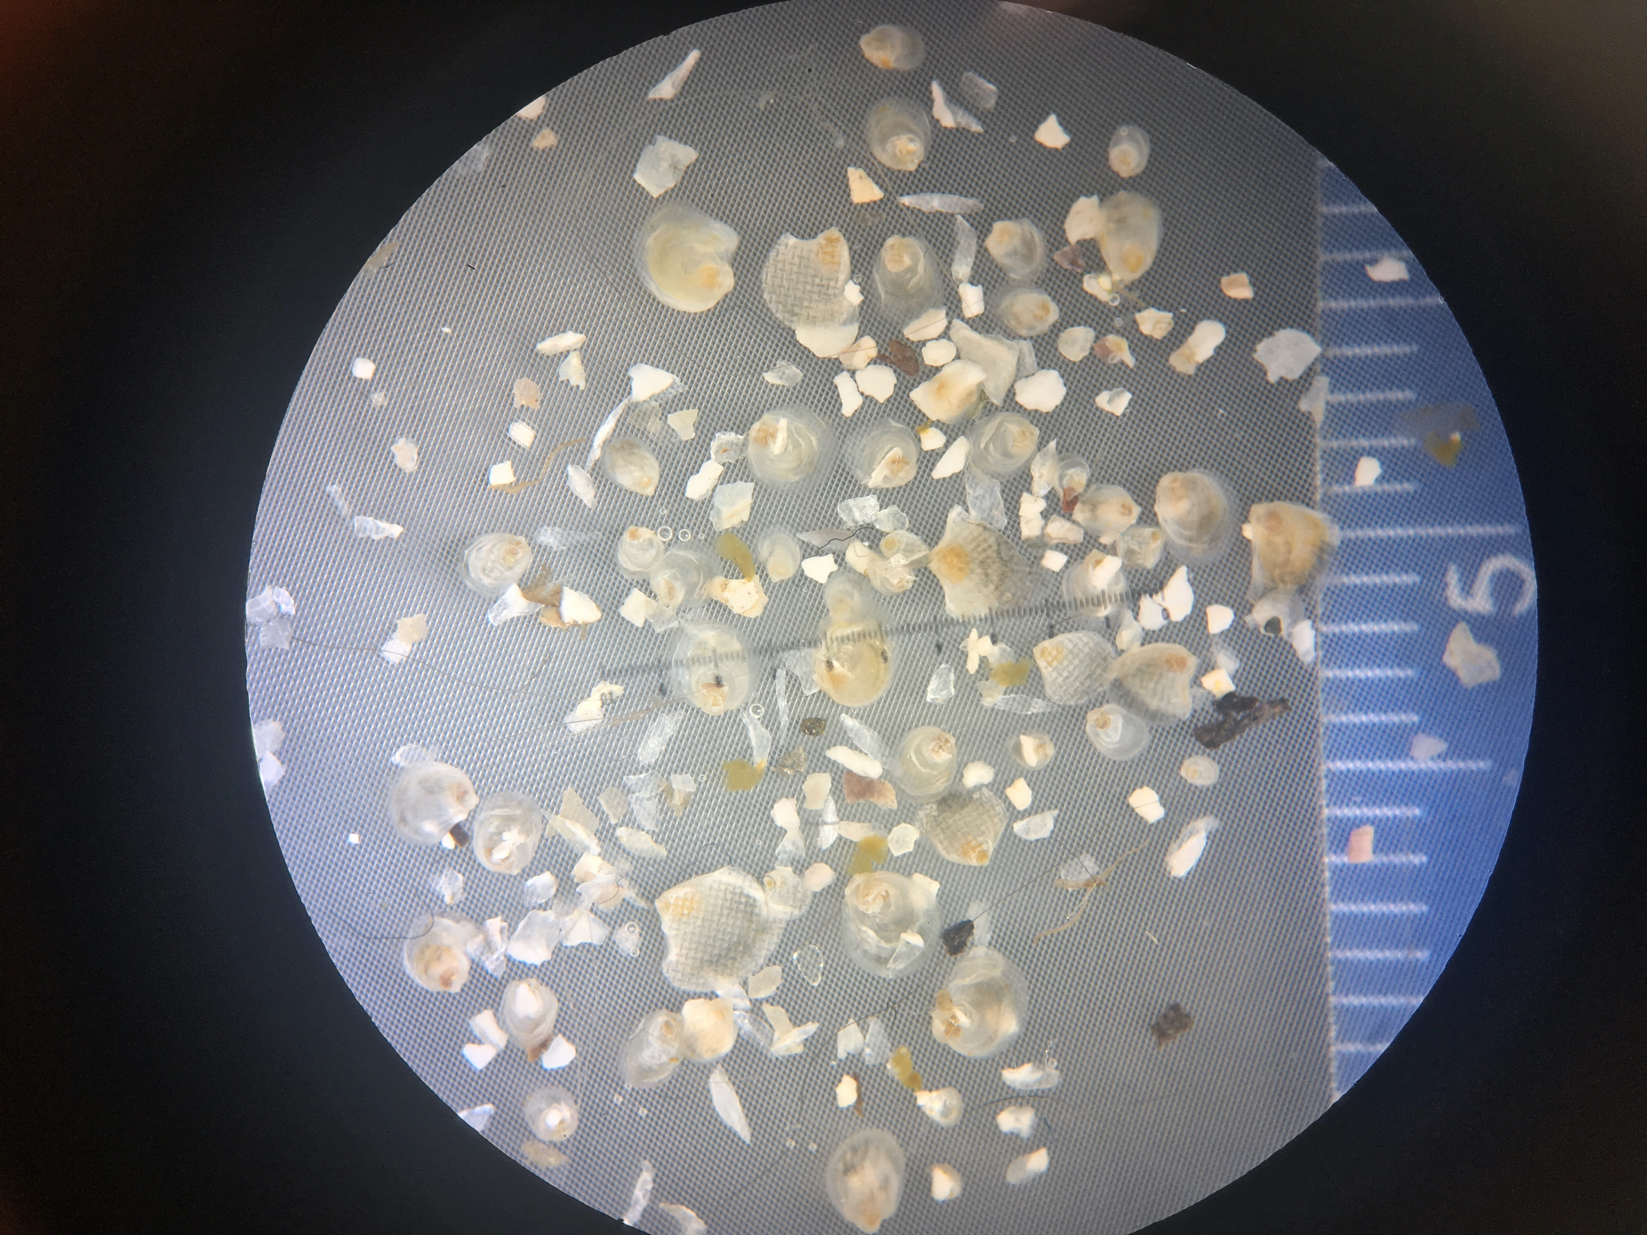
How will warmer winters impact Oly offspring?
Metrics:
Egg size (Maternal investment, endogenous energy)
Larval size when released (Larval growth rate, quality)
Larval survival to post-set (Larval viability)
Notes:
in addition to general ocean warming due to climate change, heat waves are expected to become more frequent, which will likely result in warmer winters in our region.
Clarify “when released” means

Slide 5
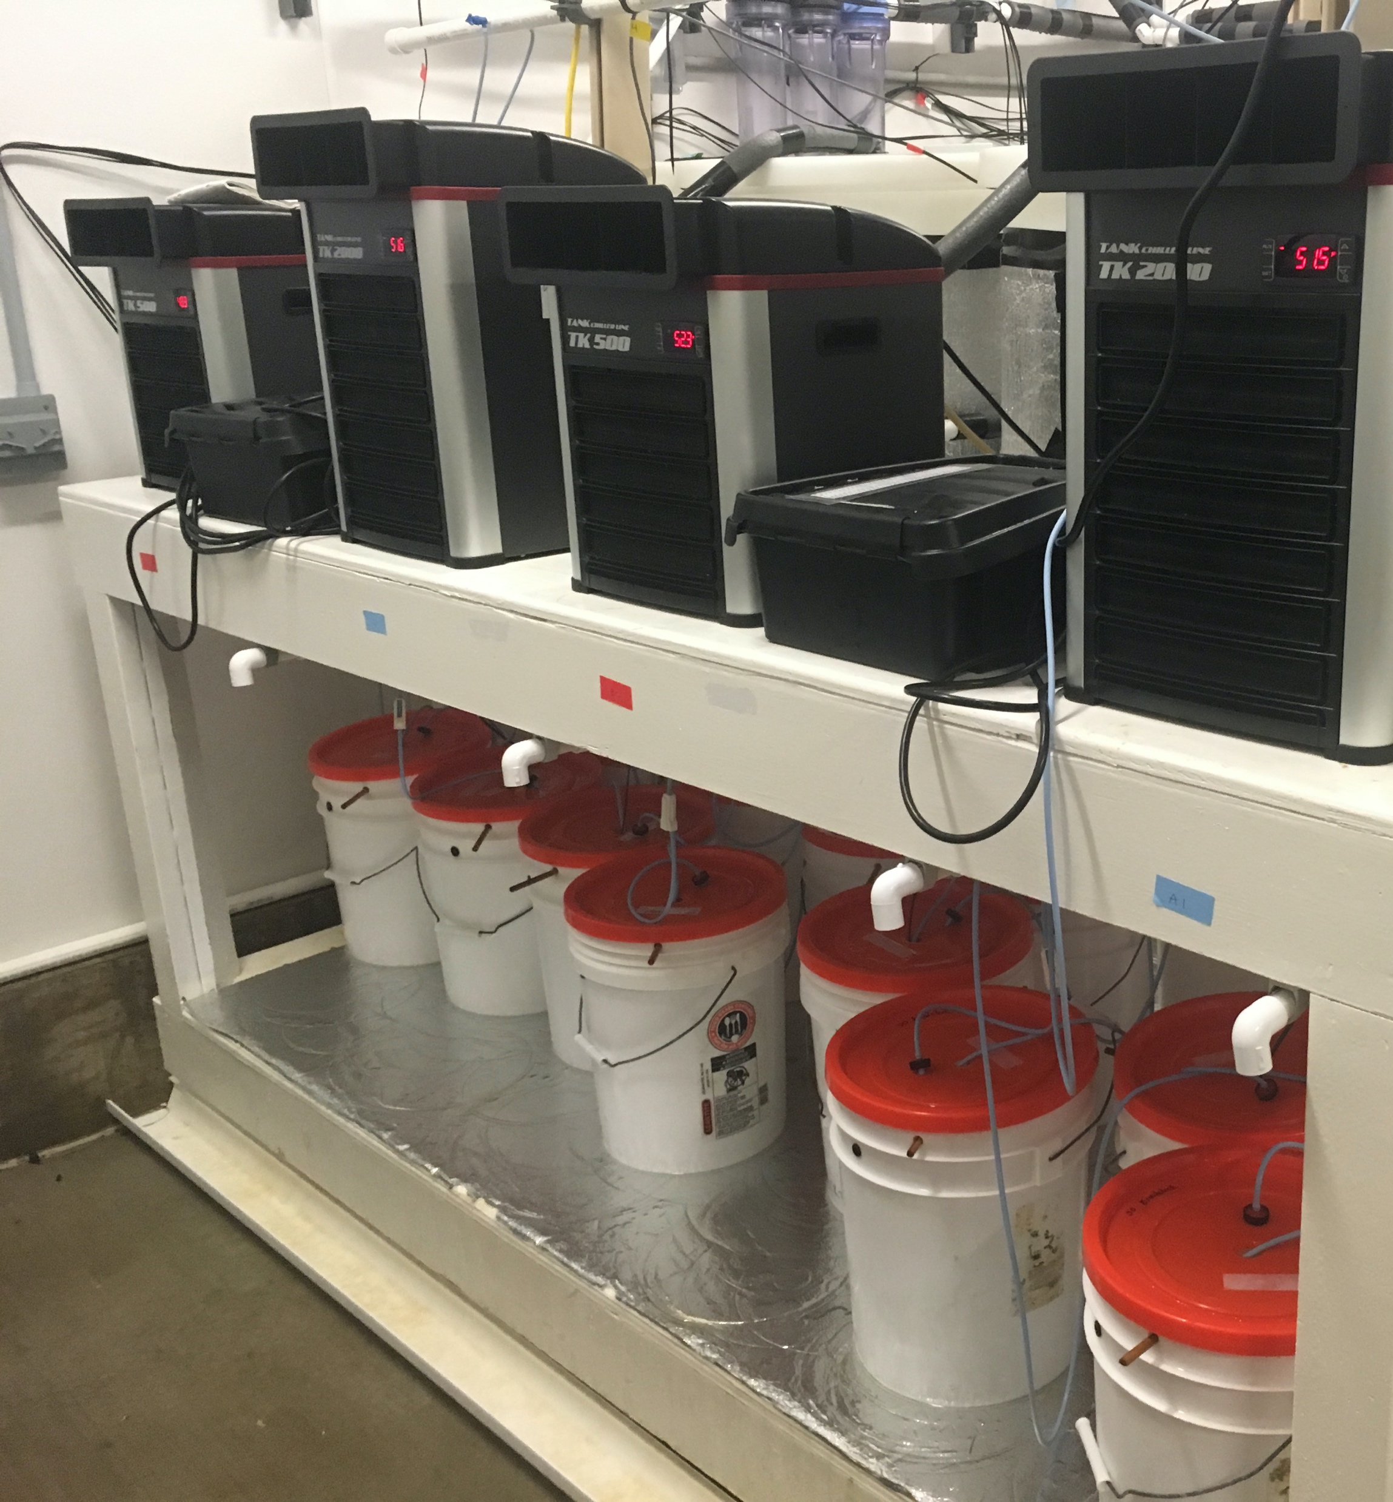
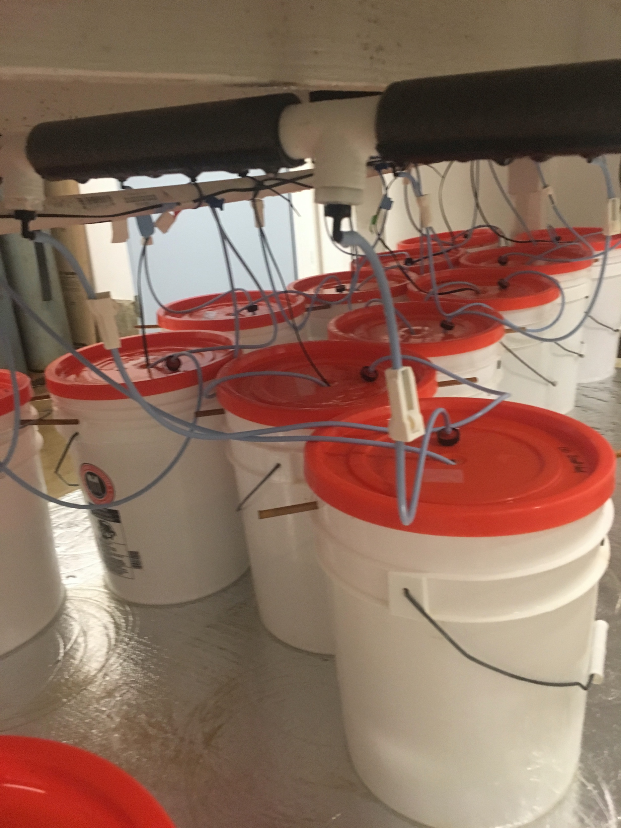
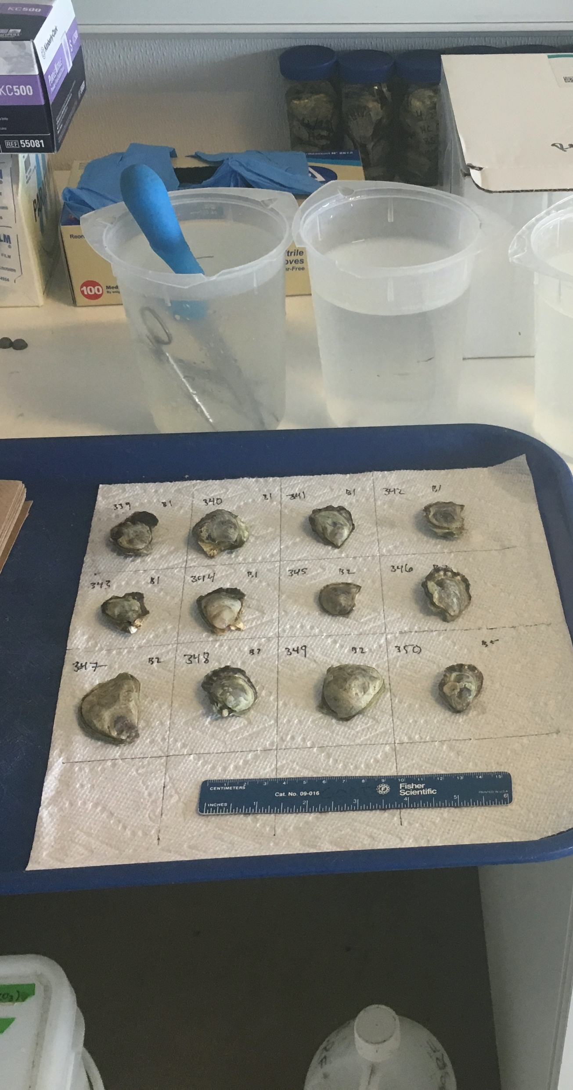
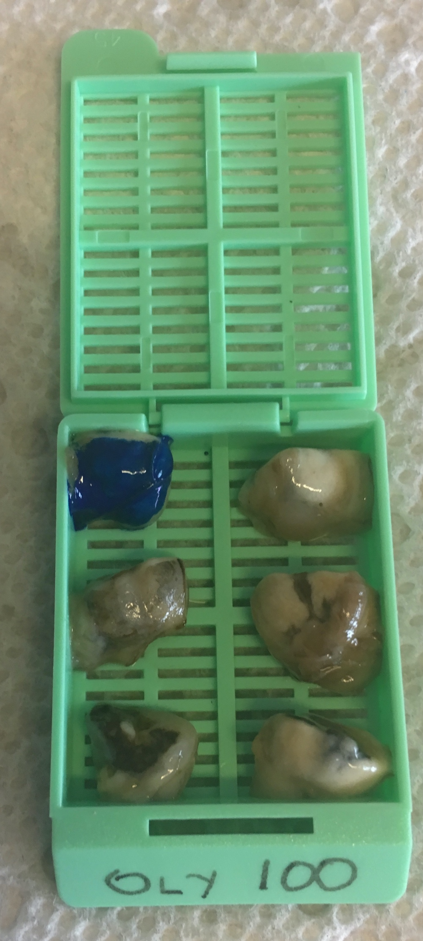
Adult temperature & food treatments for 13 weeks
4 replicates per treatment
Gonad tissue sampled
Measured eggs
Low Food
(5 cells/mL)
Ambient (7°C)
Warm (10°C)
March 2018
High Food
(50 cells/mL)
Ambient (7°C)
Warm (10°C)
WINTER
SPRING
Experimental timeline
Notes:
Just say “November 2017”
Add “Winter” and “Spring” to timeline
Bottom of timeline is too close to bottom of slide – move up / add buffer to bottom
Past OA study showed effect of stressors can be negated/lessened by high nutrition
Production angle & cost/labor savings
high/low food
heating/chilling water

Slide 6
Mature eggs were larger following winter warming
b
b
P-value = 0.019
a
a
SIDE NOTE – 98% of sampled oysters (N=386) contained gametes, no evidence of winter gonad resorption
Mature eggs
Larger eggs could mean …
Better provisioned eggs because warming triggered or increased yolk deposition?
ambient + low food
ambient + high food
warm + low food
warm + high food
Notes:
Explain boxplots –
Make lighter colors (blue and orange) darker, as is they look grayed out
Add p values & comparisons
Make all circles

Slide 7
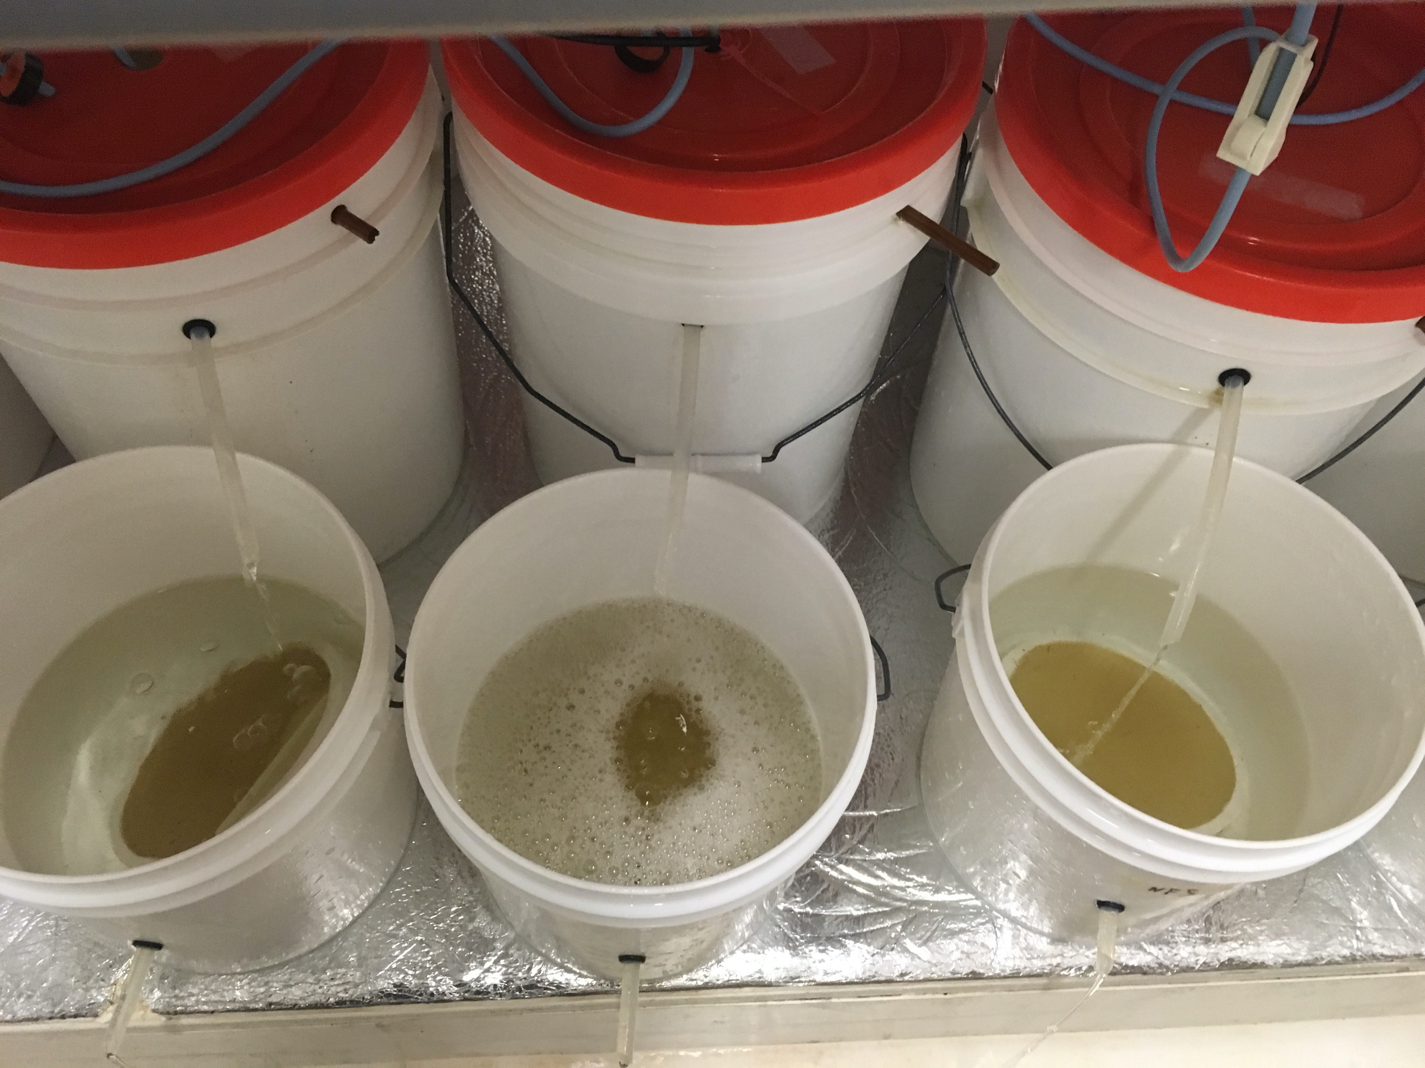
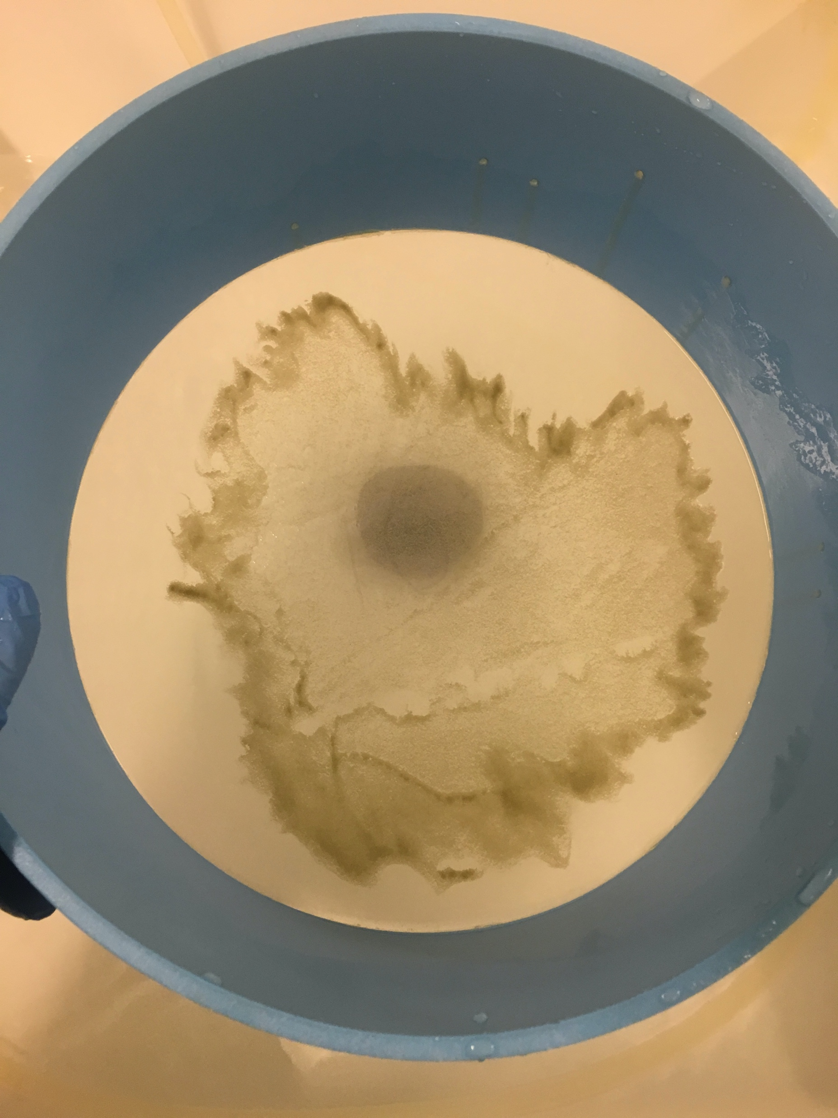
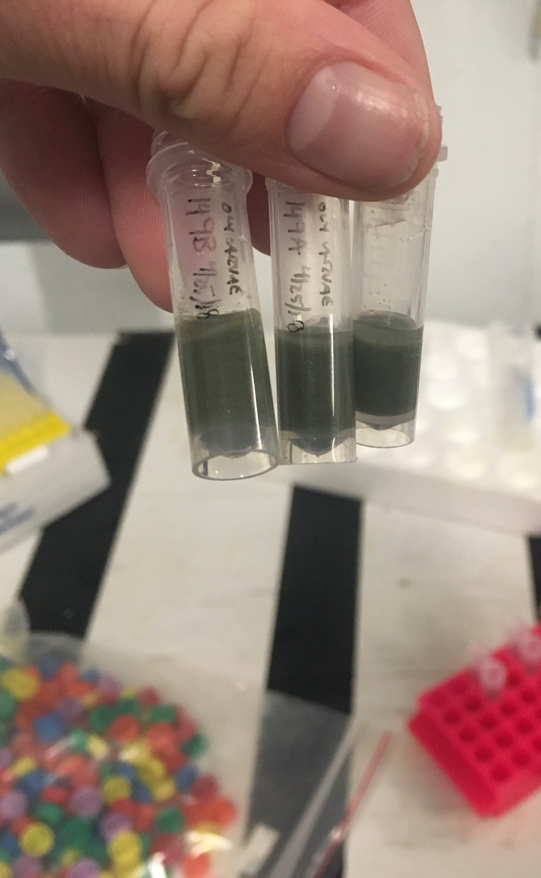
Collecting larvae upon release
Preserving larvae for measuring
Adults spawning
All in common conditions
WINTER
SPRING
Experimental timeline
Notes:
Add / clarify that adult treatments ended

Slide 8
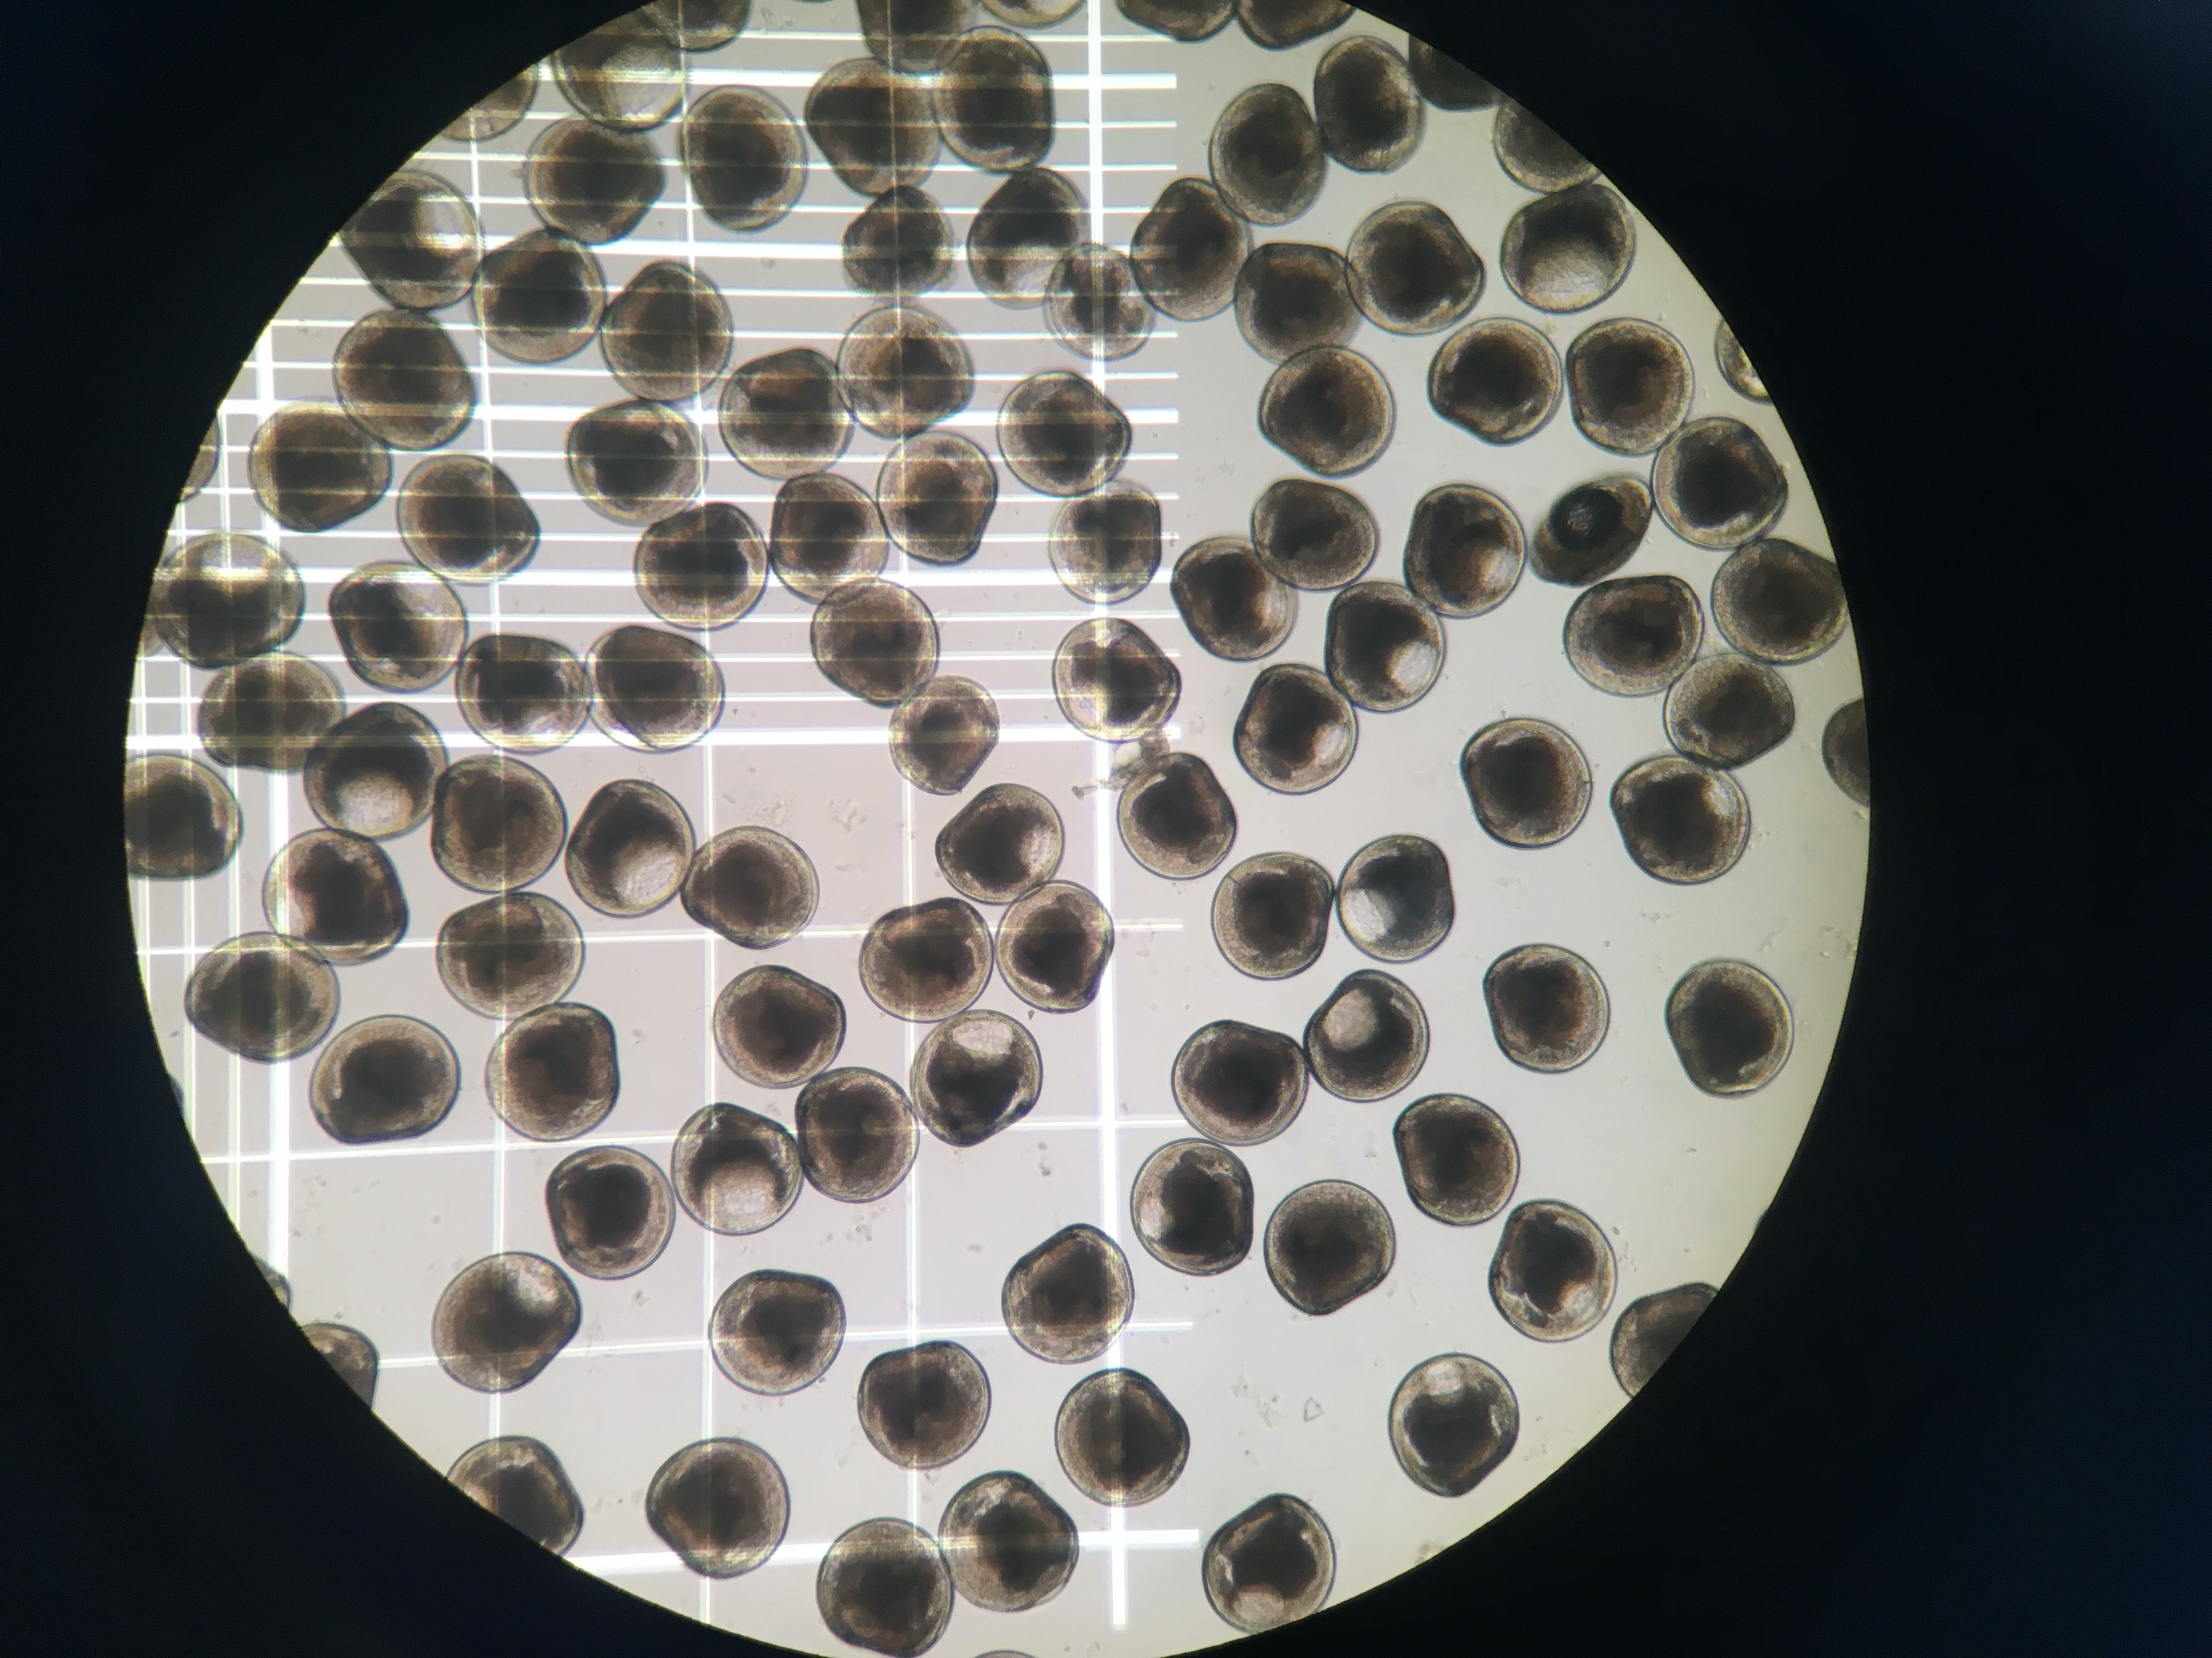
Larvae were larger when released following winter high food
P-value = 0.038
b
b
a
a
Preserved larvae
Larger larvae could mean …
Size / growth rate unaffected by winter tempeature
Impact of warming on egg size did not persist
Faster larval growth due to higher quality eggs ?
NOTE: At the time of this presentation the dataset and statistical analysis were incomplete, and did not include all larvae collected nor necessary random effect factors. Please do not reference this slide/result, but instead look for the associated paper, currently in development (Spencer, Horkan, Crim & Roberts 2021)
Adult treatment
ambient + low food
ambient + high food
warm + low food
warm + high food
Notes:
Add p values
Practice how to describe interaction between environmental factors and nutrition
Remind audience that treatments were ONLY on adults (not on larvae) – alter legend, etc.
Try to correlate average egg size : average larval size at release – how did they change? Relative growth rate?

Slide 9
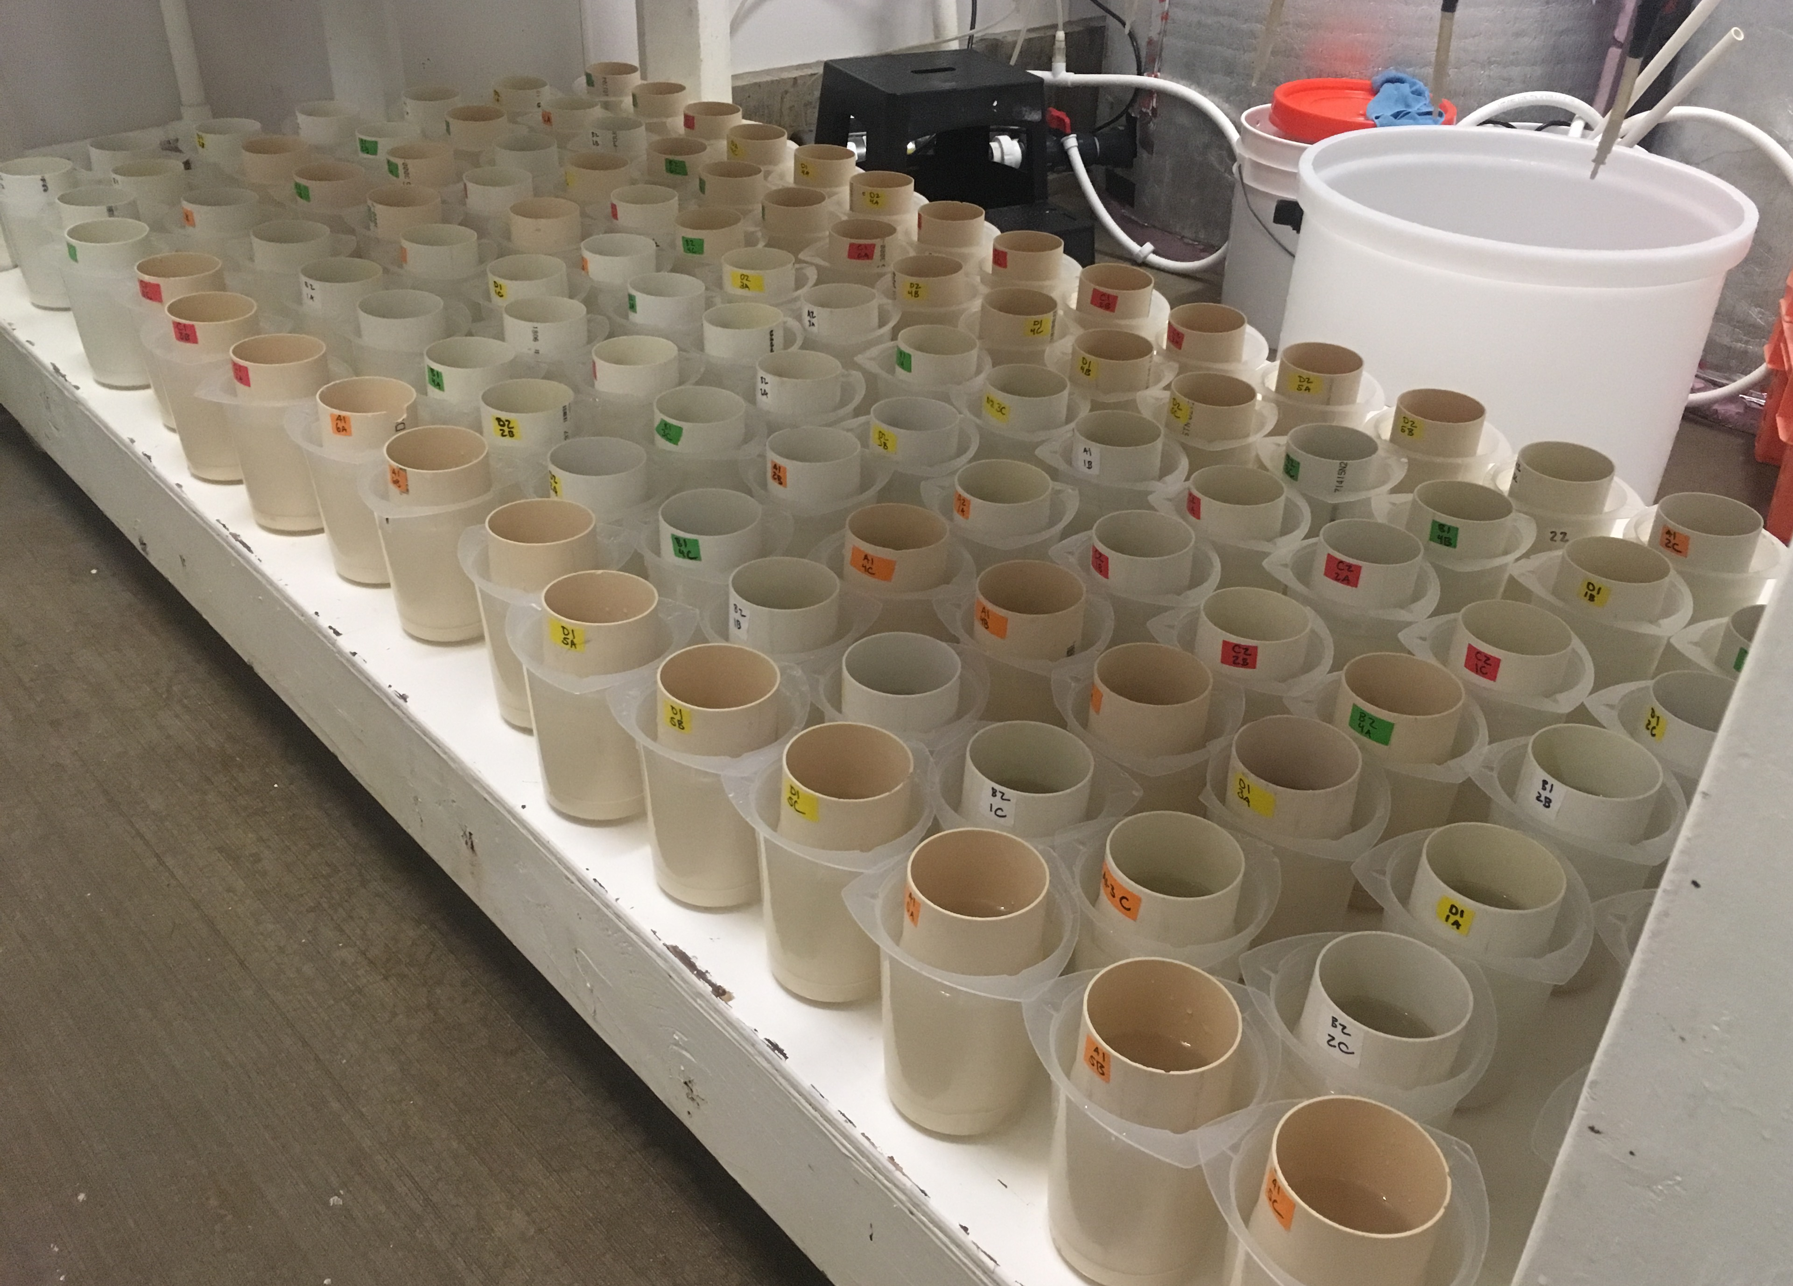
Rearing larvae
12 groups per adult treatment
3 replicates per group (N=144)
Counting post-set
All in common conditions
WINTER
SPRING
Experimental timeline
Notes:
Clarify
What a larval “group” is
Why 35 days

Slide 10
Larval survival unaffected by parental winter temperature or food level
a
a
a
a
Post-set
No effect could mean …
Egg & larvae size upon release does not correlate with survival
Good hatchery conditions masked any effects
Adult treatment
ambient + low food
ambient + high food
warm + low food
warm + high food
Notes:
Clarify treatments were only o adults not larvae
Test was a Chi-squared test run on a GLM using a quasibinomial distribution.

Slide 11
Side note – in hatchery, larval size at release did not predict survival
Adjusted R² = -0.007
Notes:
If use this, add regression line with R2 value to show no relationship … may be interesting to hatchery folks
Mention that many

Slide 12
Results summary
Mature eggs were larger following winter warming
Larval survival unaffected by adult winter conditions, egg size or larval size at release
What could this mean?
More evidence that O. lurida tolerates climate/ocean stressors, could be a future “winner” (Lawlor & Arellano 2020; Waldbusser et al. 2016; Spencer et al. 2020)
Good sign for restoration activities, hatchery production
Hatchery managers needn’t worry about broodstock holding temp & food levels during winter – could reduce costs!
In the wild, larger oocytes could mean …
Improved oocyte provisioning – more endogenous energy, higher recruitment
Notes:
Why larger larvae don’t perform better …
Hatchery managers might not need to be worried about high winter temp, OR feeding them high amounts food
Olympia oysters don’t seem to be as negatively affected … for hatchery production could diversity with Olympia oysters
This is a good sign for all the restoration activities
No effect = good!

Slide 13
Thank You
Laura H Spencer, Erin Horkan, Ryan Crim, Steven Roberts
Roberts Lab
School of Aquatic and Fishery Sciences
University of Washington
Hire me when I graduate in March 2021!

Slide 14
Extra slides

Slide 15
+ relationship between egg size & larval size
warm + high food
warm + low food
ambient + high food
ambient + low food
Preserved larvae
Mature eggs
Notes:
Add p values
Practice how to describe interaction between environmental factors and nutrition
Remind audience that treatments were ONLY on adults (not on larvae) – alter legend, etc.
Try to correlate average egg size : average larval size at release – how did they change? Relative growth rate?

Slide 16
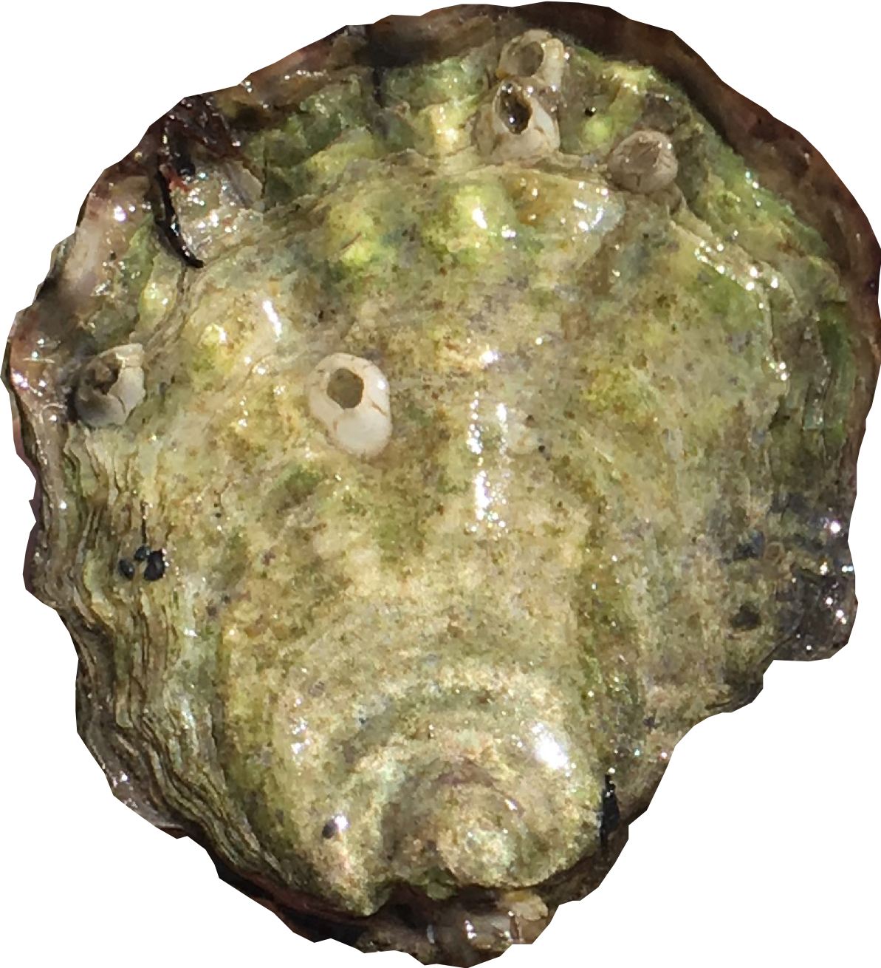
carryover effects
Signals of adults’ environmental conditions can be detected in offspring
metals
pH
temperature
oxygen
nutrition
Maternal provisioning
Epigenetic factors
Effects can be + or -
Lipid content, type
Histone modification
Maternal RNAs
DNA methylation
Carryover effects of winter warming?
Notes:
So, the question I asked was whether winter warming could carry over to impact the quality of the larve produced in the spring.
These effects have bveen observed in other studies Carryover effects of Ocean Acidification:
⬇ larval survival (Pacific oyster, Venkataraman et al. 2019)
⬆ larval growth (Sydney rock oyster, Parker et al. 2012, 2015, 2017)
⬆ juvenile survival in field (Olympia oyster, Spencer et al. 2020)

